Slide 1

SMART INDIA HACKATHON 2026
Problem Statement ID - 26044
Problem Statement Title - Portal for Academic & Industry Collaboration
Theme - Smart Automation
PS Category - Software
Team ID - ACET_SIH26_080
Team Name - SkillSync

Slide 2
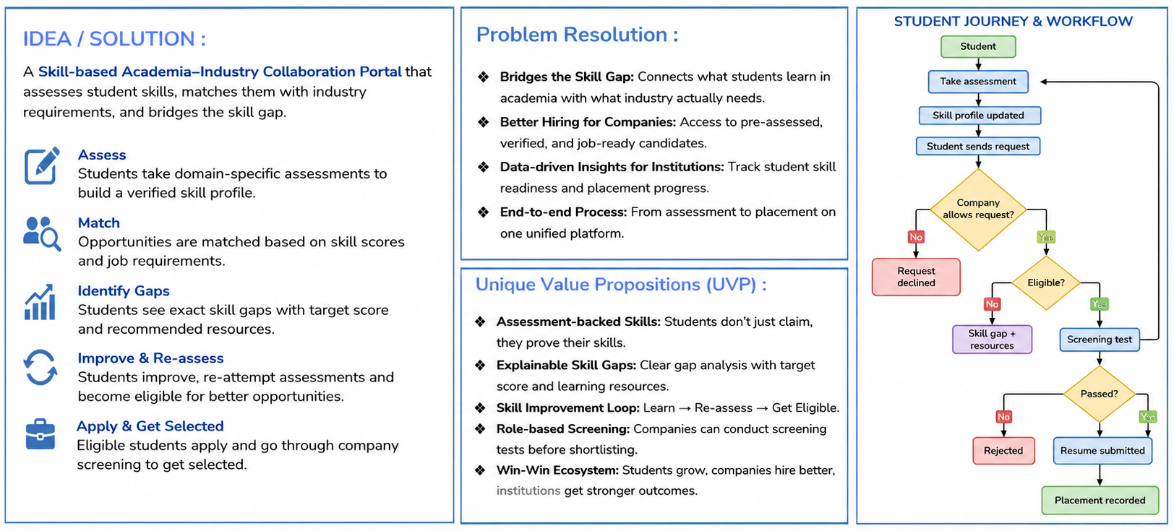
IDEA TITLE
SkillSync

Slide 3
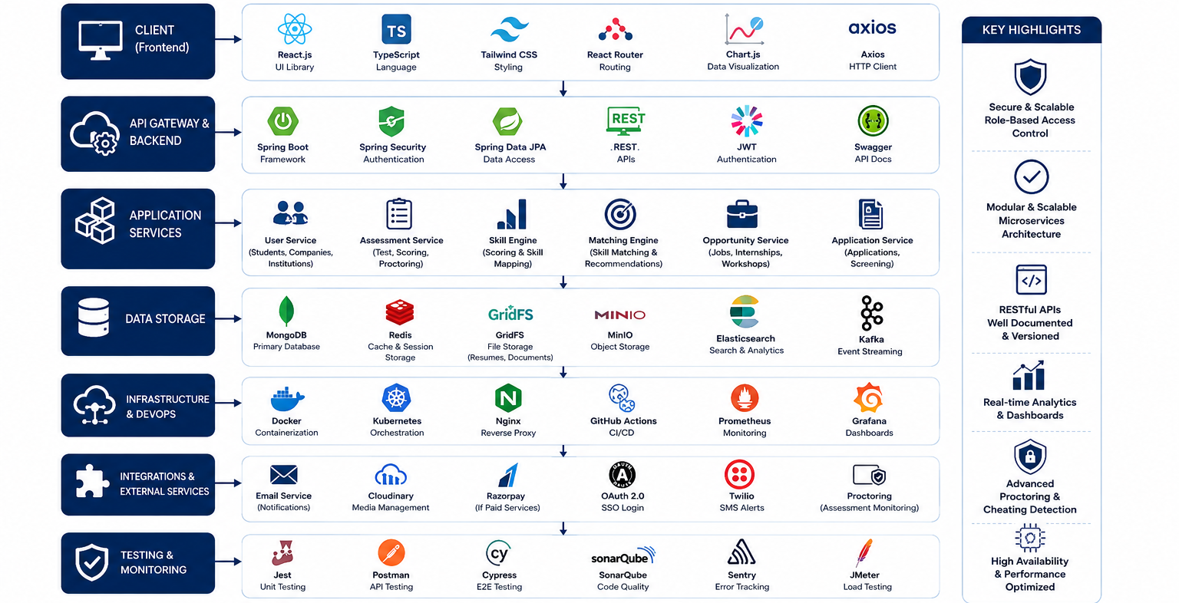
TECHNICAL APPROACH
SkillSync

Slide 4
FEASIBILITY AND VIABILITY
SkillSync
FEASIBILITY
CHALLENGES
STRATEGIES
Digital Platform: Easy-to-use web portal connecting students, colleges and industries.
🎓 Industry Participation Difficulty in getting companies actively involved.
🎯 Skill-Based Matching Match students with opportunities based on verified skills.
Skill-Based Matching: Match students with suitable internships, projects and job opportunities
🔄 Skill Gap Mismatch between student skills and industry needs.
🏢 Industry Partnerships Build strong partnerships with verified companies.
🔒 Data Privacy Protecting student and company information.
📚 Industry Training Conduct workshops and mentorship programs with industry experts.
Scalable System: Cloud-based platform that can support multiple institutions and companies
🤝 Coordination Managing communication between students, colleges & industries
📊 Continuous Feedback Use feedback to improve skills, courses and opportunities.
Low-Cost Deployment: Uses existing digital infrastructure with minimal setup and maintenance.
@SIH Idea submission- Template
4

Slide 5
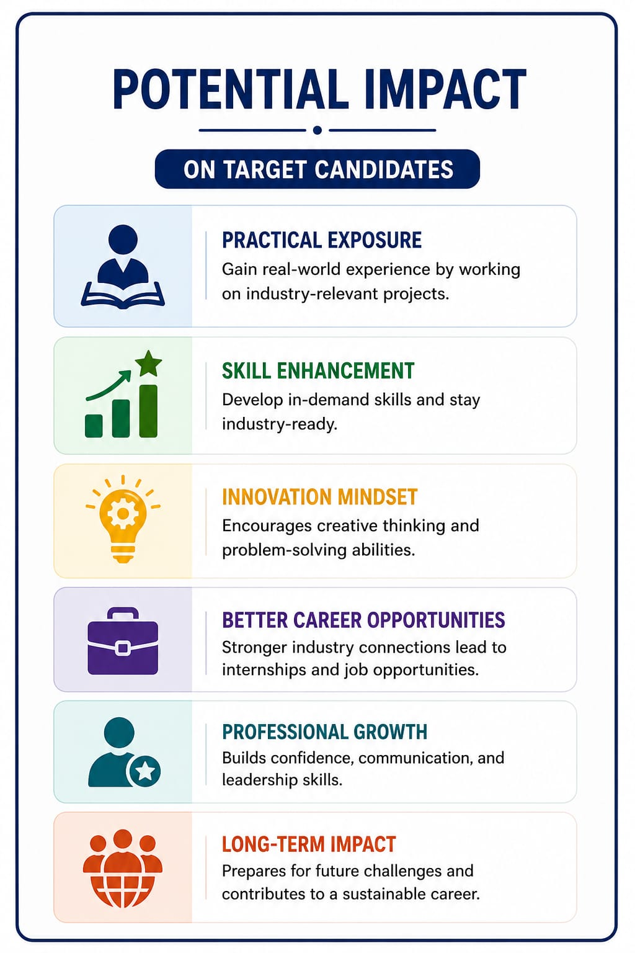
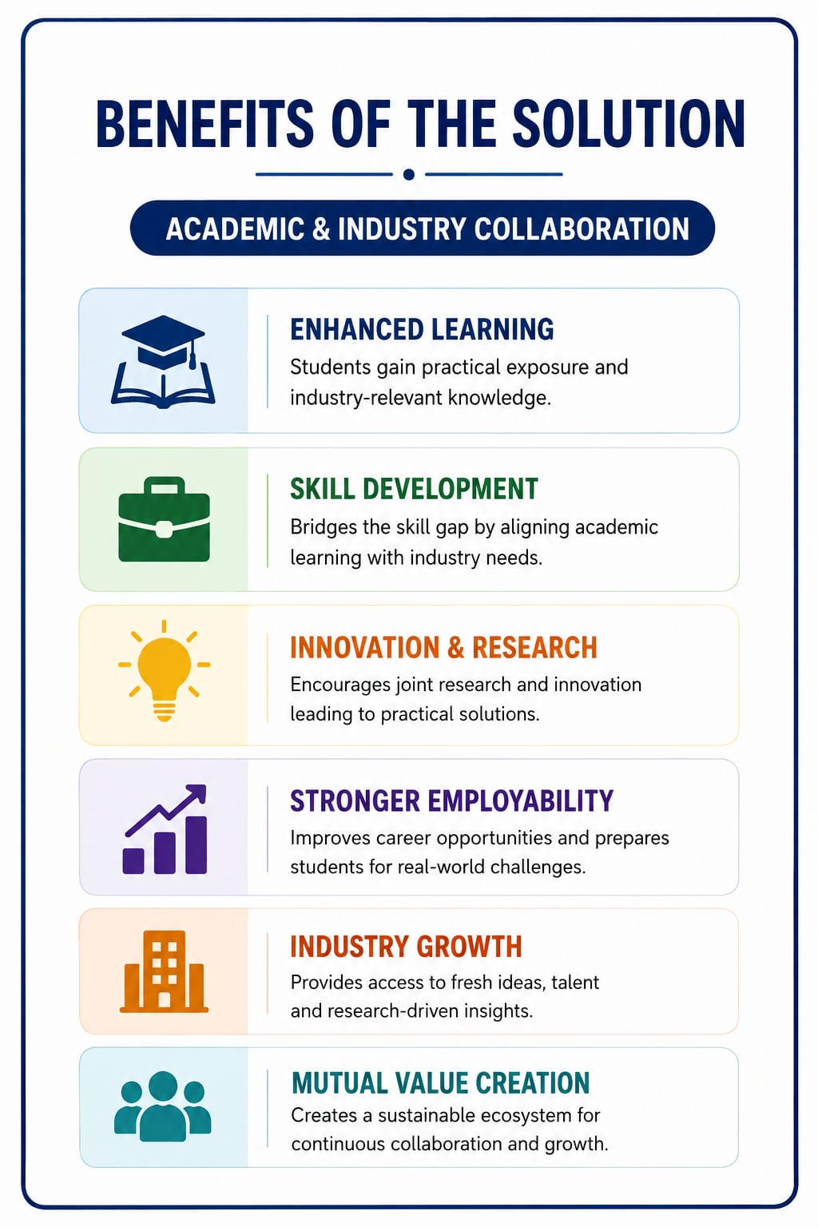
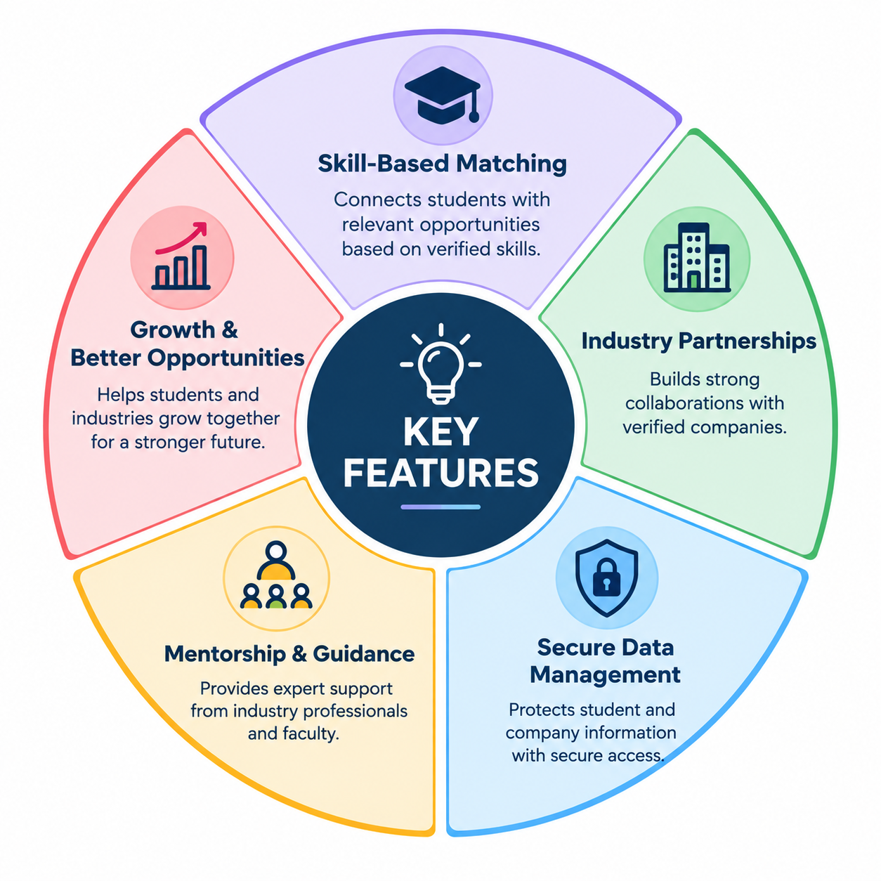
IMPACT AND BENEFITS
SkillSync
🧑‍🎓 For Students
Get industry-relevant internships, projects, and jobs.
Develop practical, job-ready skills.
🏢 For Industries
Access verified and skilled student talent.
Reduce hiring and training time.
🤝 For Academia
Strengthen industry connections and collaboration.
Improve placement outcomes through real-world learning.

Slide 6
RESEARCH AND REFERENCES
SkillSync
1. INDUSTRY & SKILL DEVELOPMENT
2. ACADEMIA & PRACTICAL EXPOSURE
•
World Economic Forum — Future of Jobs Report 2025
Changing jobs, skills and workforce requirements.
🔗 weforum.org/publications/the-future-of-jobs-report-2025/
•
UGC — Internship / Research Internship Guidelines
Structured internships and practical industry exposure.
🔗 ugc.gov.in/e-book/ResearchInternship/
•
NSDC — National Occupational Standards
Industry-aligned job roles, skills and assessment standards.
🔗 nsdcindia.org/national-occupational-standards-and-model-curriculum
•
UGC — University–Industry Linkage Guidelines
Framework for stronger university–industry collaboration. Helping in understanding the relations among them
🔗 ugc.gov.in/Guideline
•
Skill India Digital Hub
Skills, courses, assessments and employment recommendations.
🔗 skillindiadigital.gov.in/about-us
•
National Education Policy 2020
Promotes practical learning, skilling and industry–academia linkage.
🔗 education.gov.in/nep/about-nep
Research basis: Industry skill demand • Skill assessment • Practical exposure • Academia–industry collaboration

